Slide 1
Business Decision Support
Session 3
Farha Imthiyaz,
BSc (Hons) in Software Engineering
(Solent University, UK),
MS in Data Science (Reading)
(NED University of Engineering & Technology, Karachi)

Slide 2

Road Map
What is a Decision?
Business Decision
Decision Making
Steps in Decision Making
Data Driven Decision Management (DDDM)
Data Driven Decision Making
Some Facts about DDDM
Business Decision with Figures
Three types of Decisions
Case Study

Slide 3
What is a Decision?
A choice made between alternative courses of action in a situation of uncertainty.
A decision is an act of selection or choice of one action from several alternatives.
"Should I get up or hit the snooze button?"

Slide 4
Business Decision
Choosing between alternatives which leads to the success of the business.

Slide 5
Decision Making
Decision-making can be defined as the process of selecting a right and effective course of action from two or more alternatives for the purpose of achieving a desired result.

Slide 6
Steps in Decision Making
Define the Problem
Develop Alternatives
Evaluate Alternatives
Make the Decision
Implement the Solution
Monitor Your Solution

Slide 7
Data Driven Decision Management (DDDM)
Data-driven decision management (DDDM) is an approach to business governance that values decisions that can be backed up with verifiable data.

Slide 8
Data Driven Decision Making
Today, business intelligence tools often require very little, if any, support from the IT department. Business managers can customize dashboards to display the data they want to see and run custom reports on the fly. The changes in how data can be mined and visualized allows business executives who have no technology backgrounds to be able to work with analytics tools and make data-driven decisions.

Slide 9
Some Facts about DDDM
Data-driven decision management is usually undertaken as a way to gain a competitive advantage. A study from the MIT Center for Digital Business found that organizations driven most by data-based decision making had 4% higher productivity rates and 6% higher profits.

Slide 10
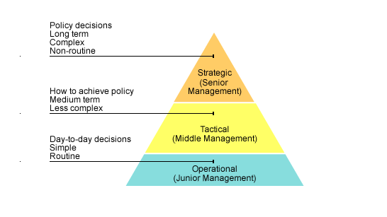
Business Decision

Slide 11
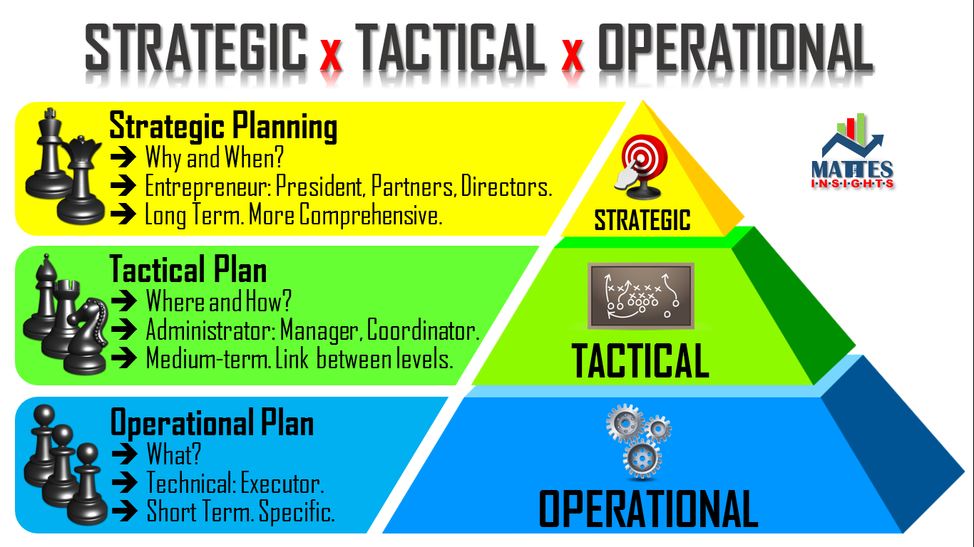
Business Decision

Slide 12
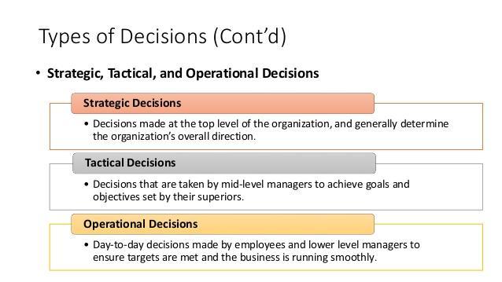
Business Decision

Slide 13
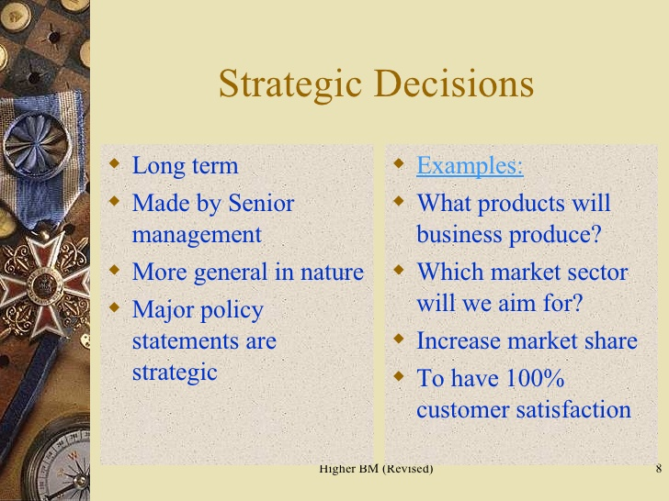
Strategic Decisions

Slide 14
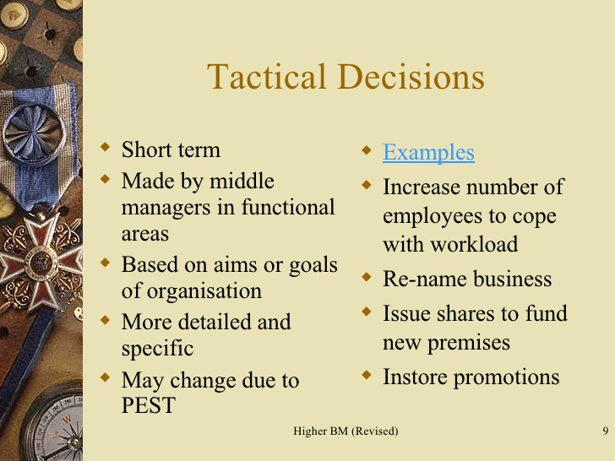
Tactical Decisions

Slide 15
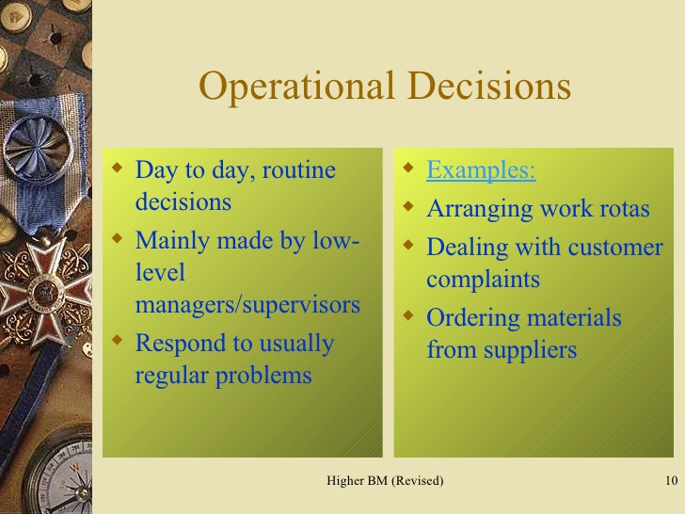
Operational Decisions

Slide 16
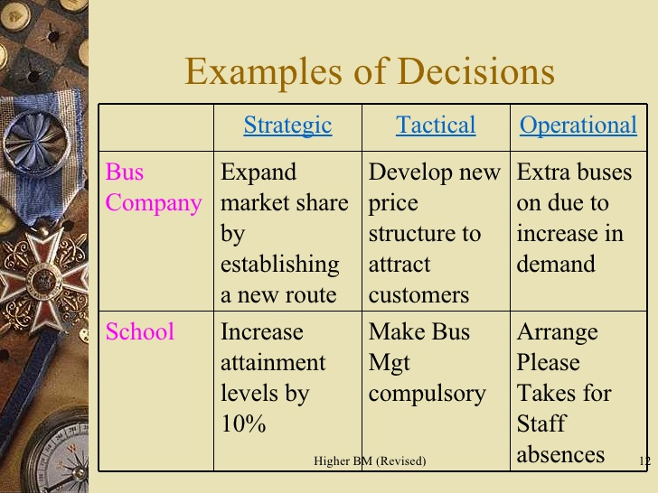
Examples of Decisions

Slide 17
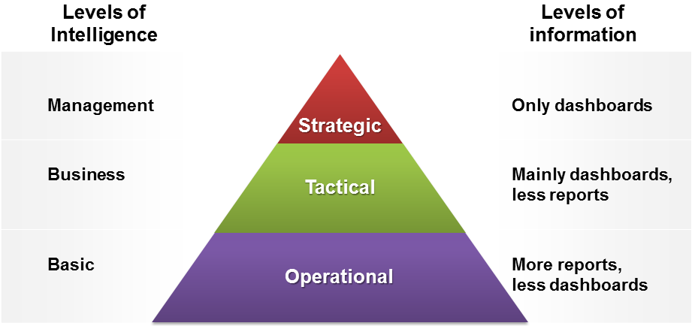
Business Decision

Slide 18
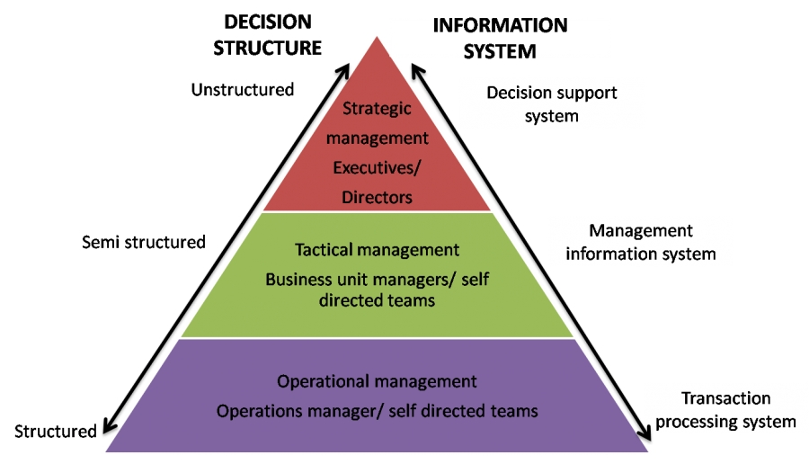
Business Decision Making

Slide 19
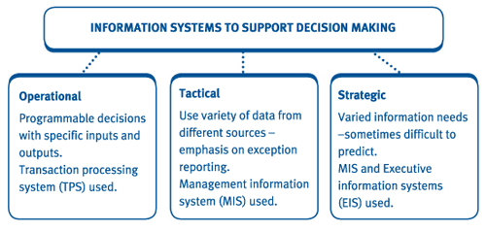
Business Decision

Slide 20

Case Study
Practical activity: Students to find examples of transaction processing systems, management information systems, decision support systems and expert systems.
Get into groups
Read and analyze the case study
Present the results

Slide 21


